Slide 1
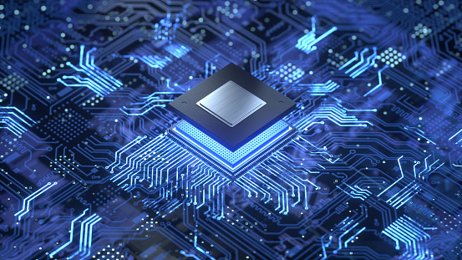
COA COURSE PROJECT
Course and Project Guide:
Prof. Satyadhyan R Chickerur

Slide 2

Team members:
Mayuri Kalmat 01FE20BCS095 230
Parag Hegde 01FE20BCS096 231
Pranav Jadhav 01FE20BCS099 234
Aim : To design and simulate a 16-bit processor.

Slide 3
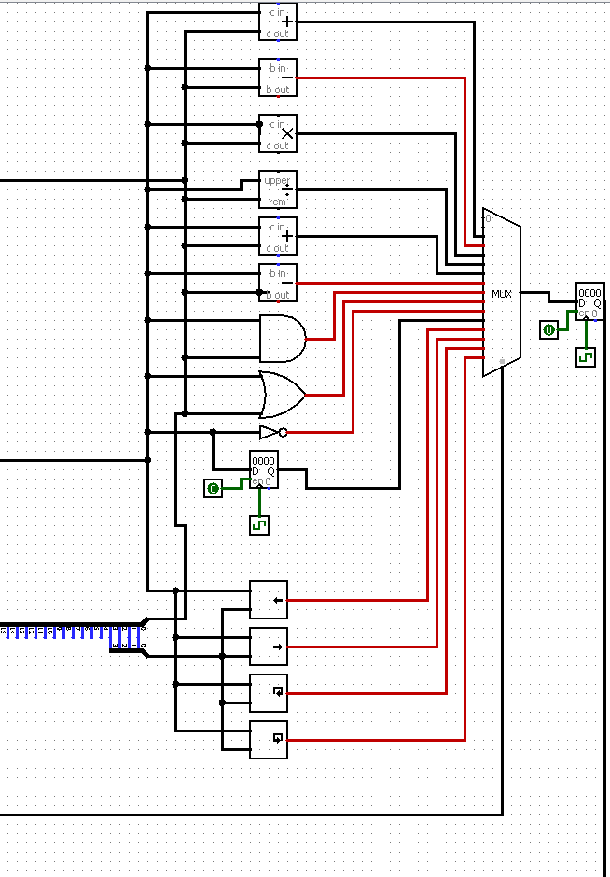
Arithmetic Logic unit
An Arithmetic Logic Unit (ALU) in computing is a combinational digital circuit that performs arithmetic and bitwise operations on integer binary numbers.
This is in contrast to a Floating-Point Unit (FPU), which operates on floating point numbers.
A multiplexer (MUX) is a device that can receive multiple input signals and synthesize a single output signal in a recoverable manner for each input signal.
It is also an integrated system that usually contains a certain number of data inputs and a single output.

Slide 4
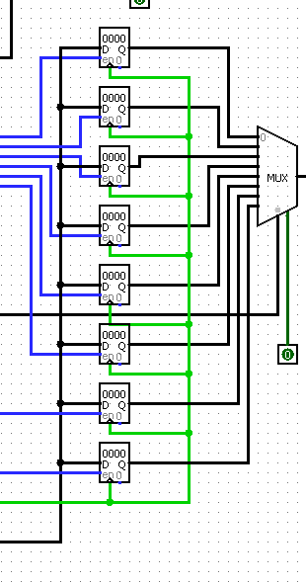
Registers
Registers are a type of computer memory made up of several flip flops used to quickly accept, store, and transfer data and instructions that are being used immediately by the CPU.
The registers used by the CPU are often termed as Processor registers.
A processor register may hold an instruction, a storage address, or any data (such as bit sequence or individual characters).
The computer needs processor registers for manipulating data and a register for holding a memory address.
The register holding the memory location is used to calculate the address of the next instruction after the execution of the current instruction is completed.

Slide 5
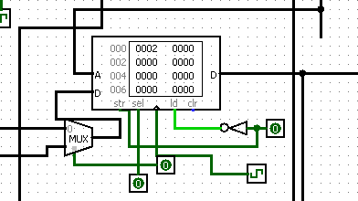
Main memory
Main memory: Very closely connected to the processor.
The contents are quickly and easily changed. Holds the programs and data that the processor is actively working with.
This interacts with the processor millions of times per second.

Slide 6

Accumulator
An accumulator is a register for short-term, intermediate storage of arithmetic and logic data in a computer's CPU (central processing unit).
The most elementary use for an accumulator is adding a sequence of numbers.
The numerical value in the accumulator increases as each number is added.

Slide 7
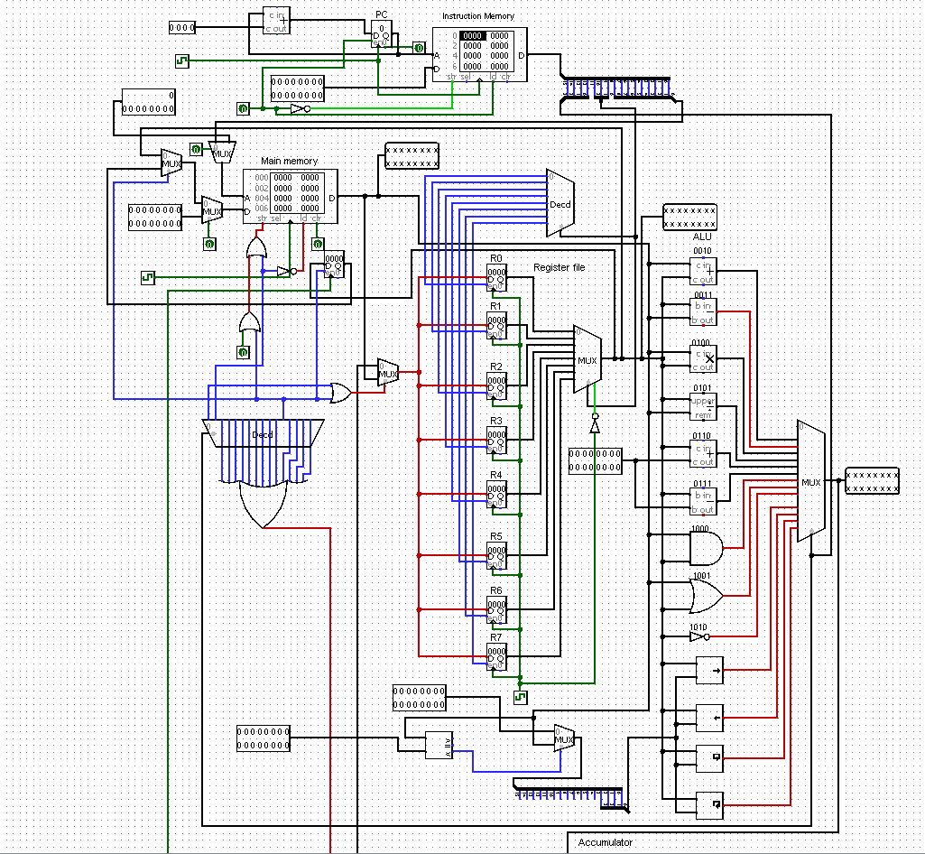
16 bit processor:

Slide 8
TAKE AWAY FROM THIS PROJECT: We learnt the complete functionality of the Processor. We visualized how data flows from one part to another part of register. We were able to appreciate the organization of processor and its functionalities.

Slide 9
Resources: Wikipedia (https://en.wikipedia.org/wiki/16-bit_computing). YouTube videos. GitHub documents.

Slide 10
THANK YOU

